Slide 1
Project 1 6103
Zheyue Wang

Slide 2
Content
The purpose of this project:
Part I. GDP VS Military expenditure
Part II. Overall military expenditure
absolute
percentages
Part III. Military per capita VS GDP per capita
absolute
2. percentage
Part IV. The fastest growing countries in military spending
1. absolute
2. percentage
Among 10 countries:
US, China, Russia, Germany, UK, France, Italy, Saudi Arabia, S. Korea, Israel

Slide 3
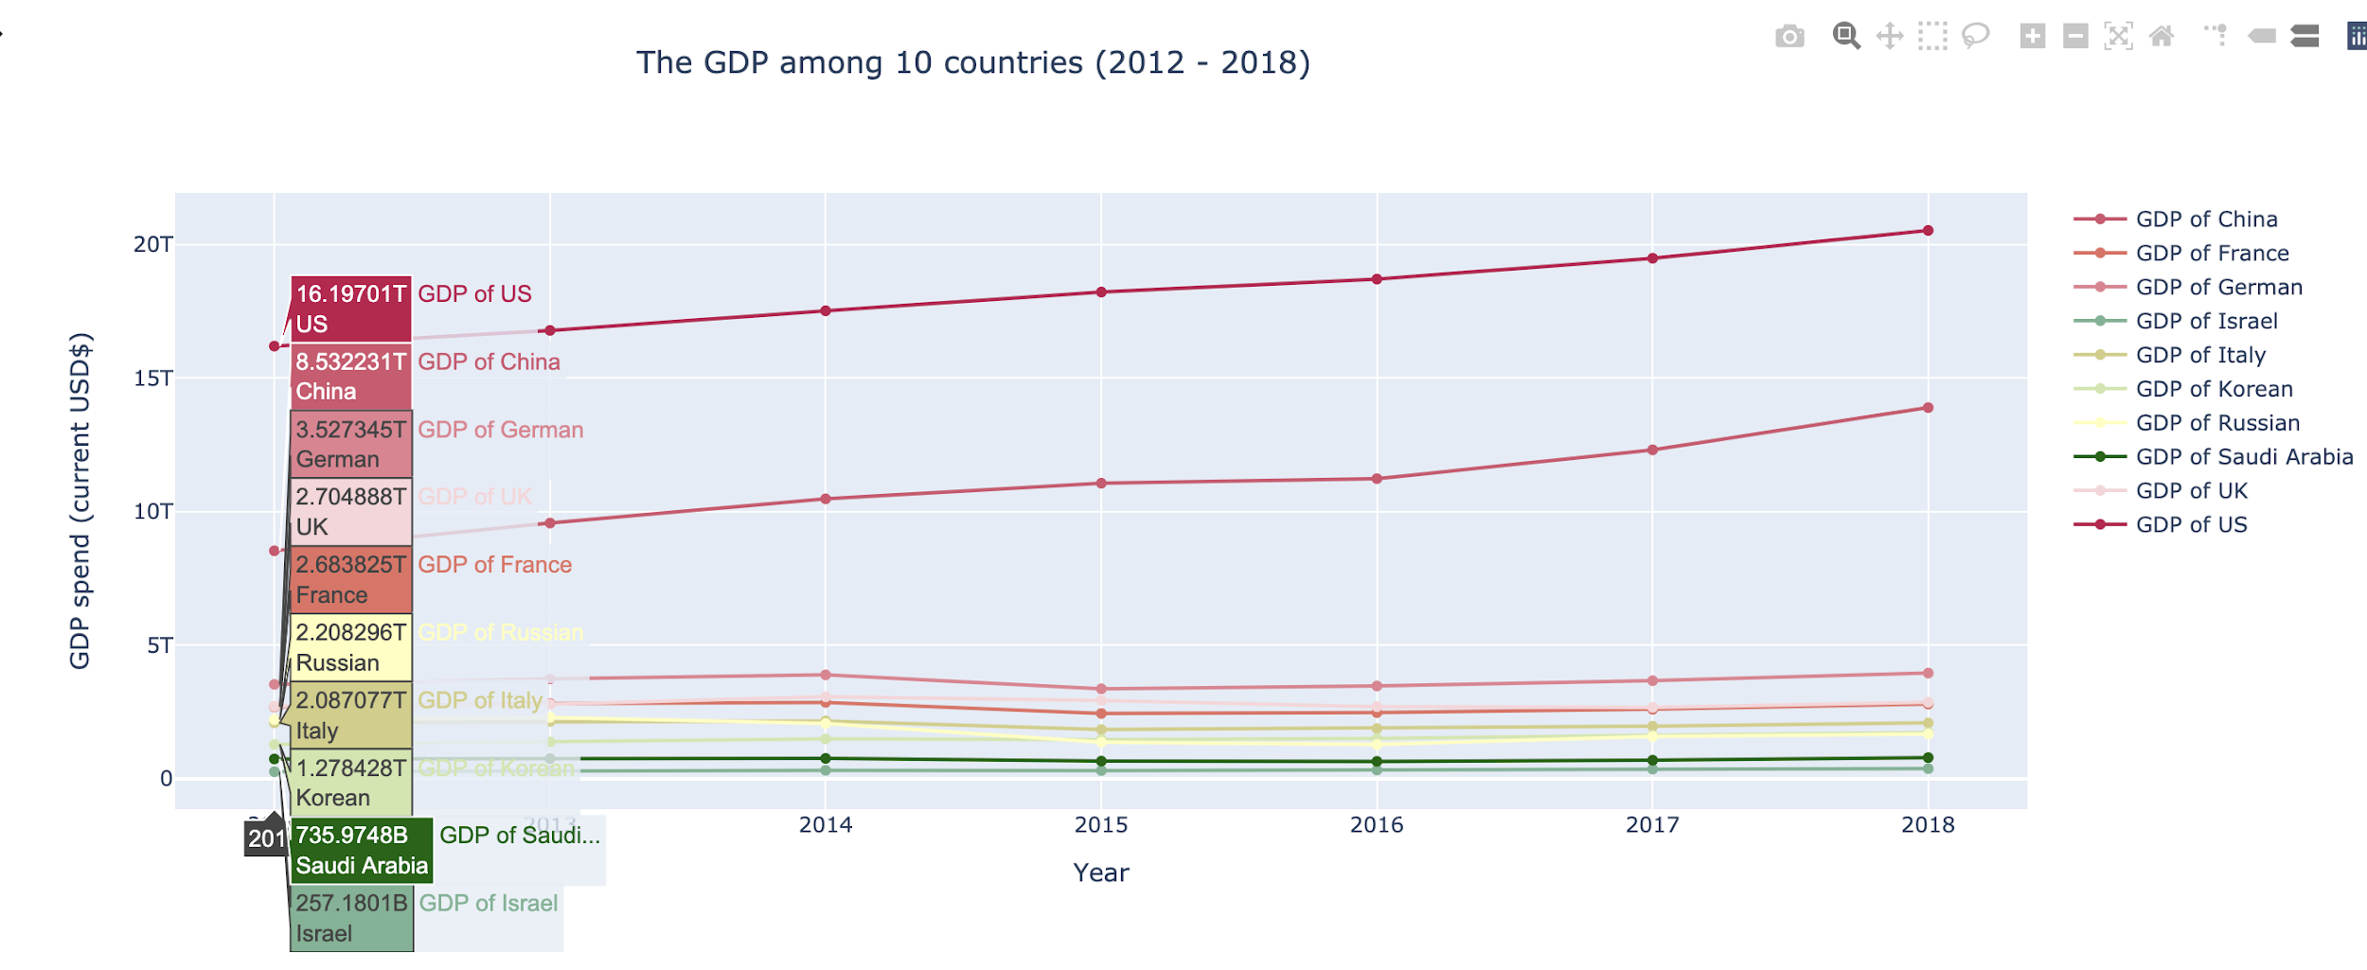
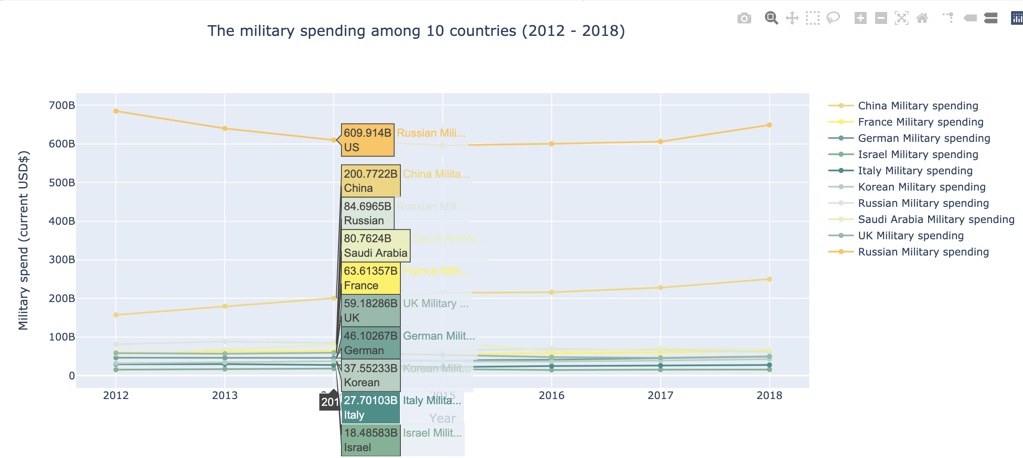
Part I
GDP
Military expenditure
GDP VS Military expenditure

Slide 4
GDP
In general, the GDP of the United States and China showed an upward trend in seven years.
Among the ten countries, the top two countries with the largest GDP are:
U.S
China
For Saudi Arabia and Israel, GDP growth flat.
From 2014 to 2015, the GDP of Germany, the UK, France, Russia, and Italy showed a downward trend.
There is a gap between the GDP of the United States and China, and the GDP of China and Germany.
Each line represents the GDP of a country. This line graph ranks 10 countries by their GDP

Slide 5
Military Expenditure
The United States and China spend far more on their armed forces than the other eight countries.
Among the 10 countries, the United States still has the highest military expenditure.
Israel has the lowest military expenditure.
From 2012 to 2014, the United States military expenditure has been on a downward trend.
In general, the military expenditure of a rest eight countries has been developing steadily.

Slide 6
Couclution
GDP
In general:
The United States and China are the top two countries in both GDP and military expenditure
Military expenditure

Slide 7
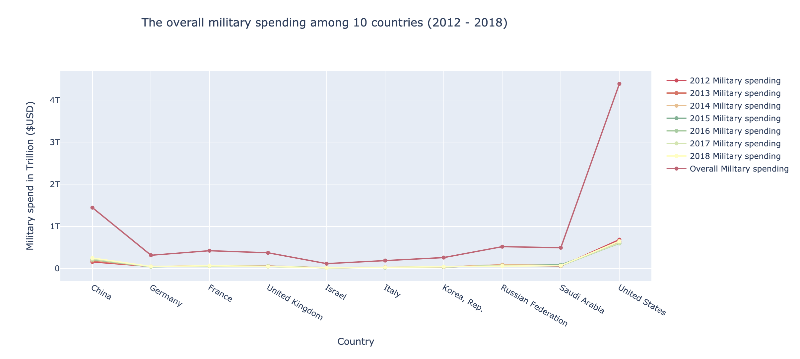
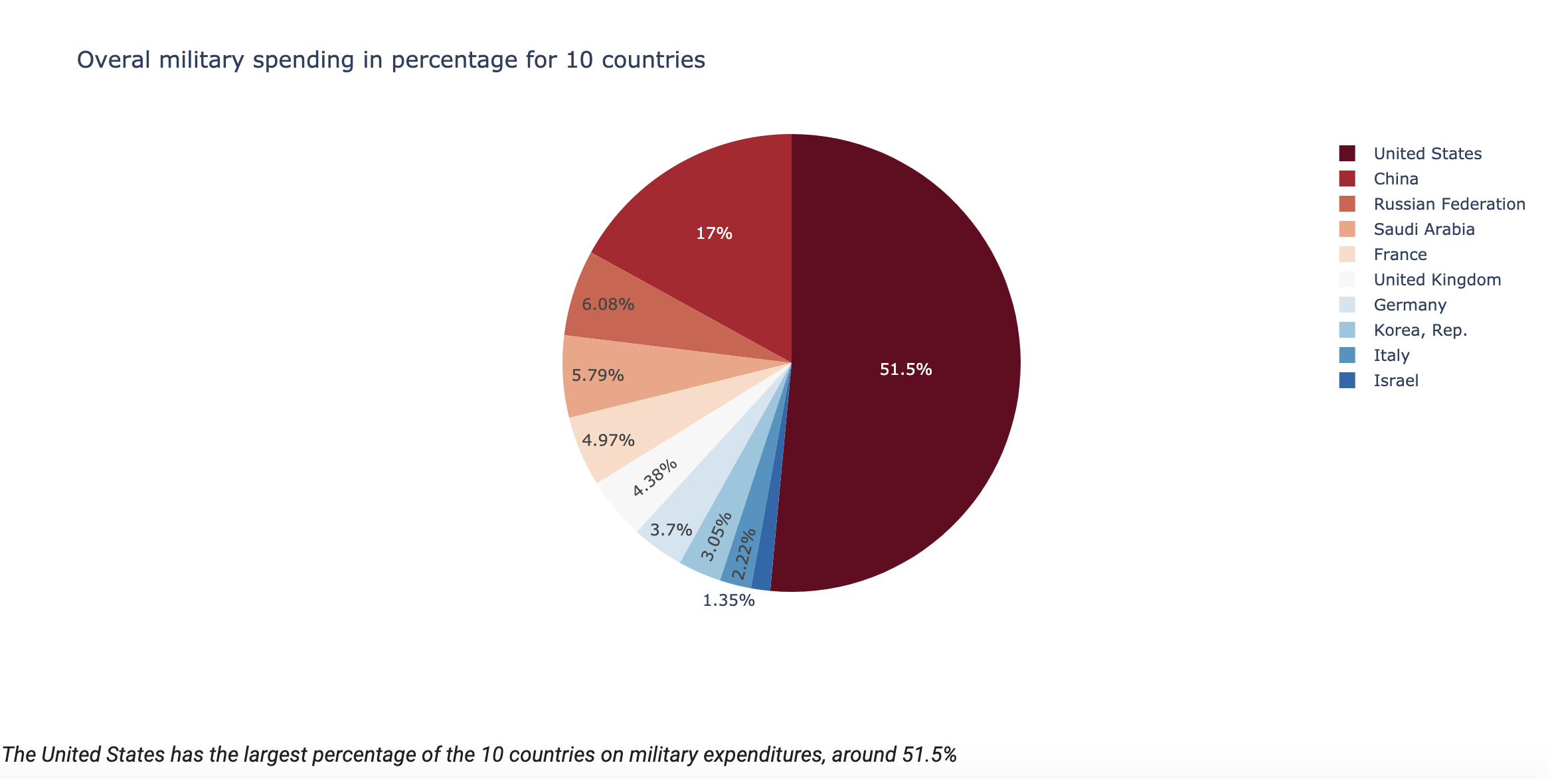
Part II:
BBy absolute value
By percentage
Overall military expenditure among 10 countries

Slide 8
By absolute value
Among the total ten countries, the United States is the highest country for overall military spending.

Slide 9
By percentage
The United States has the largest percentage of the ten countries on military expenditures.
The military expenditure of China is the second-highest among the rest of the countries.
The military expenditure of the rest of the eight countries is below 10%.

Slide 10
Conclution:
BBy absolute value
By percentage
Compare the absolute value and the percentage, the United States is the most highest country on military expenditure among 10 countries.

Slide 11
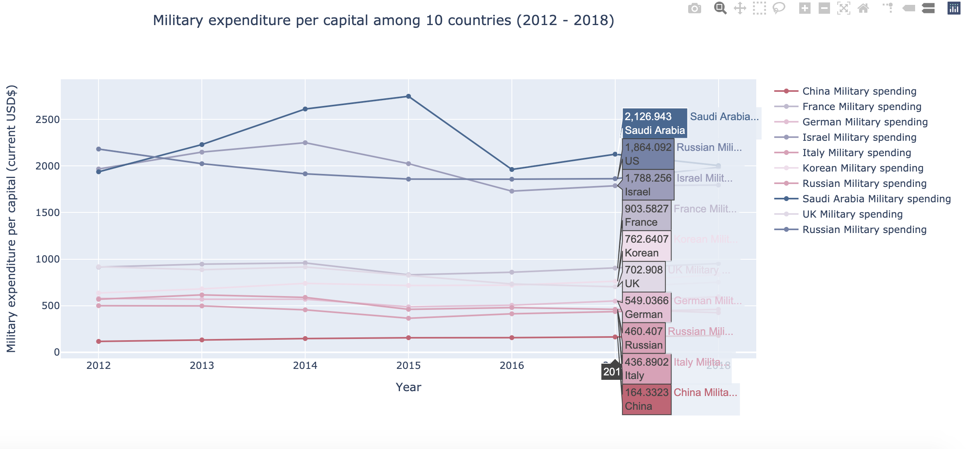
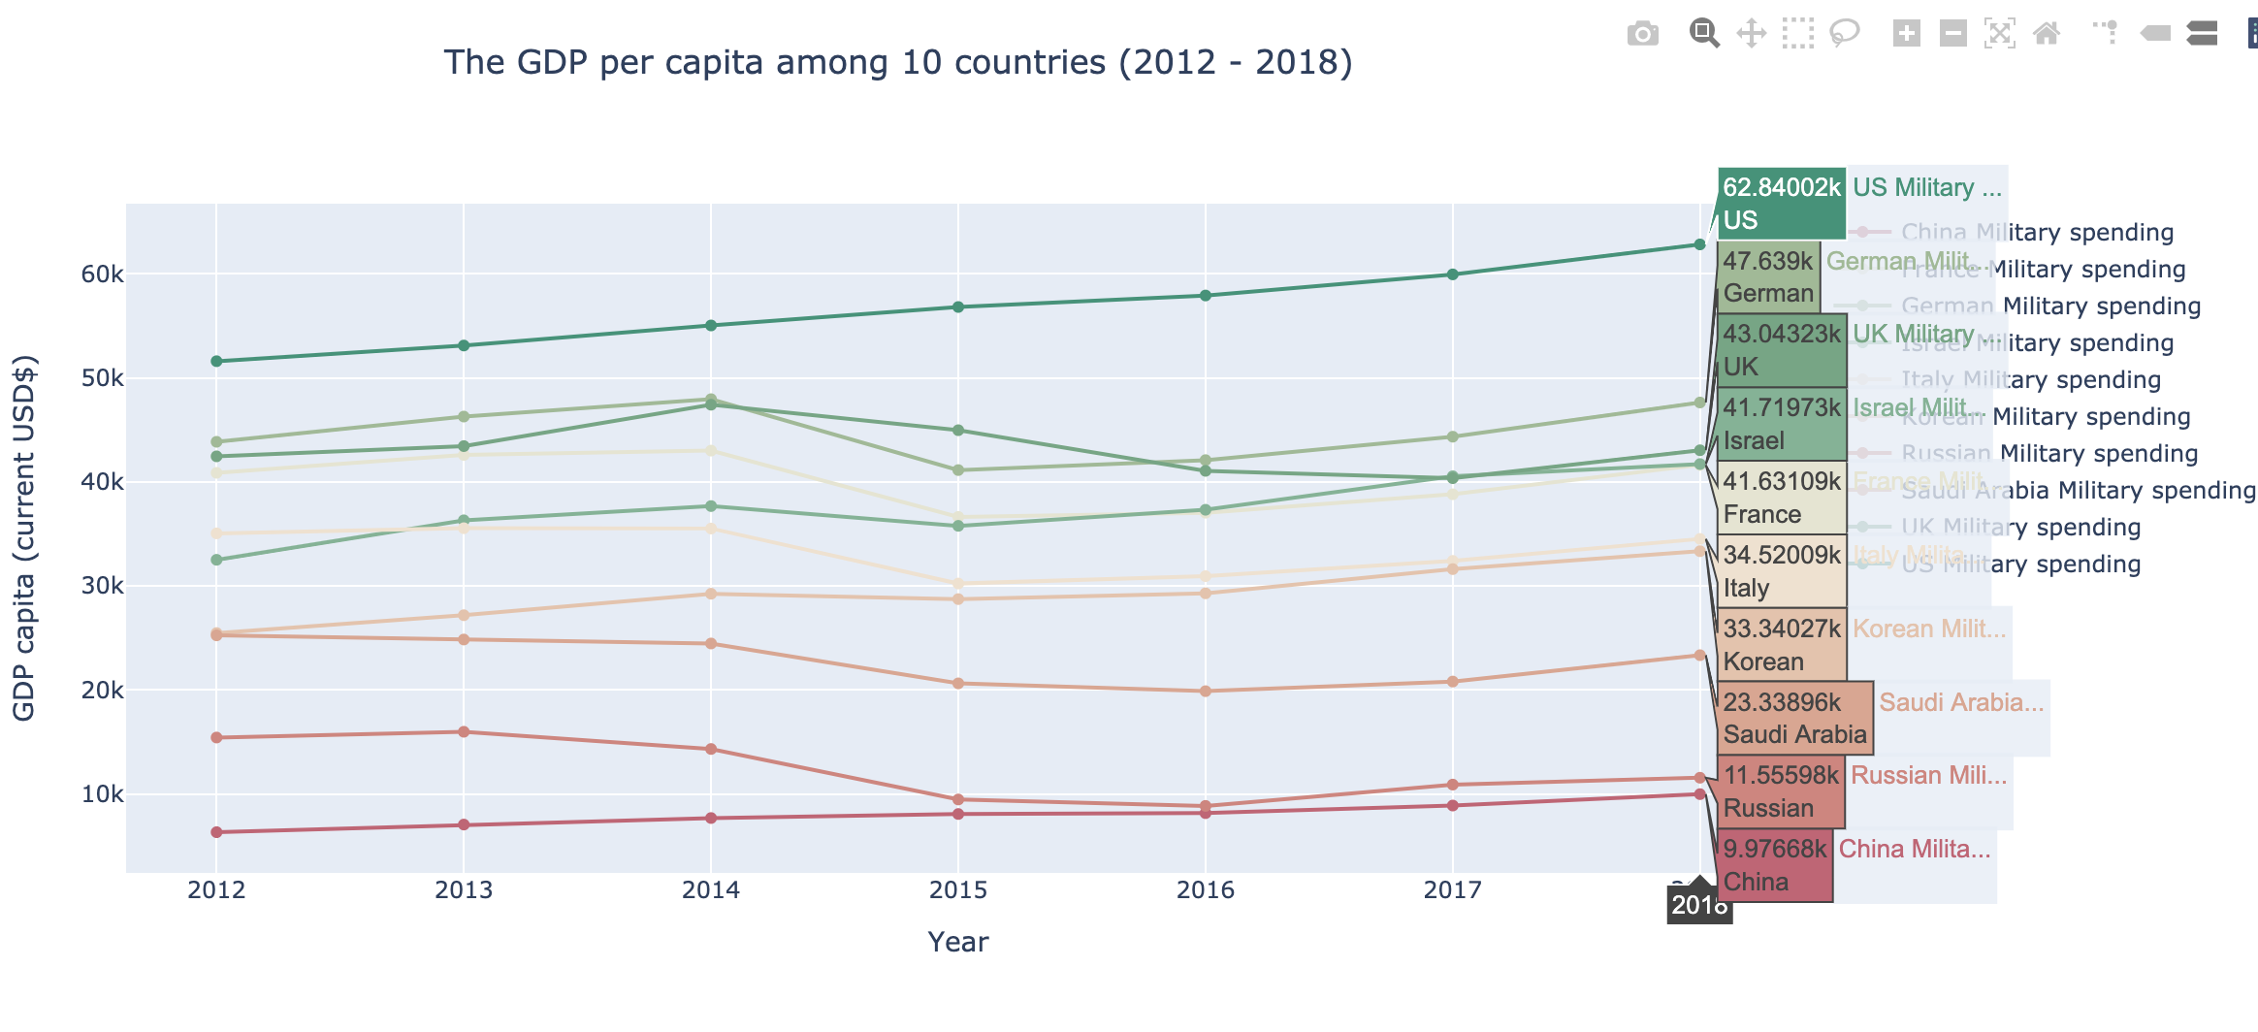
Part III:
Military per capita
Military per capita VS GDP per capita.:
By absolute value
GDP per capita

Slide 12
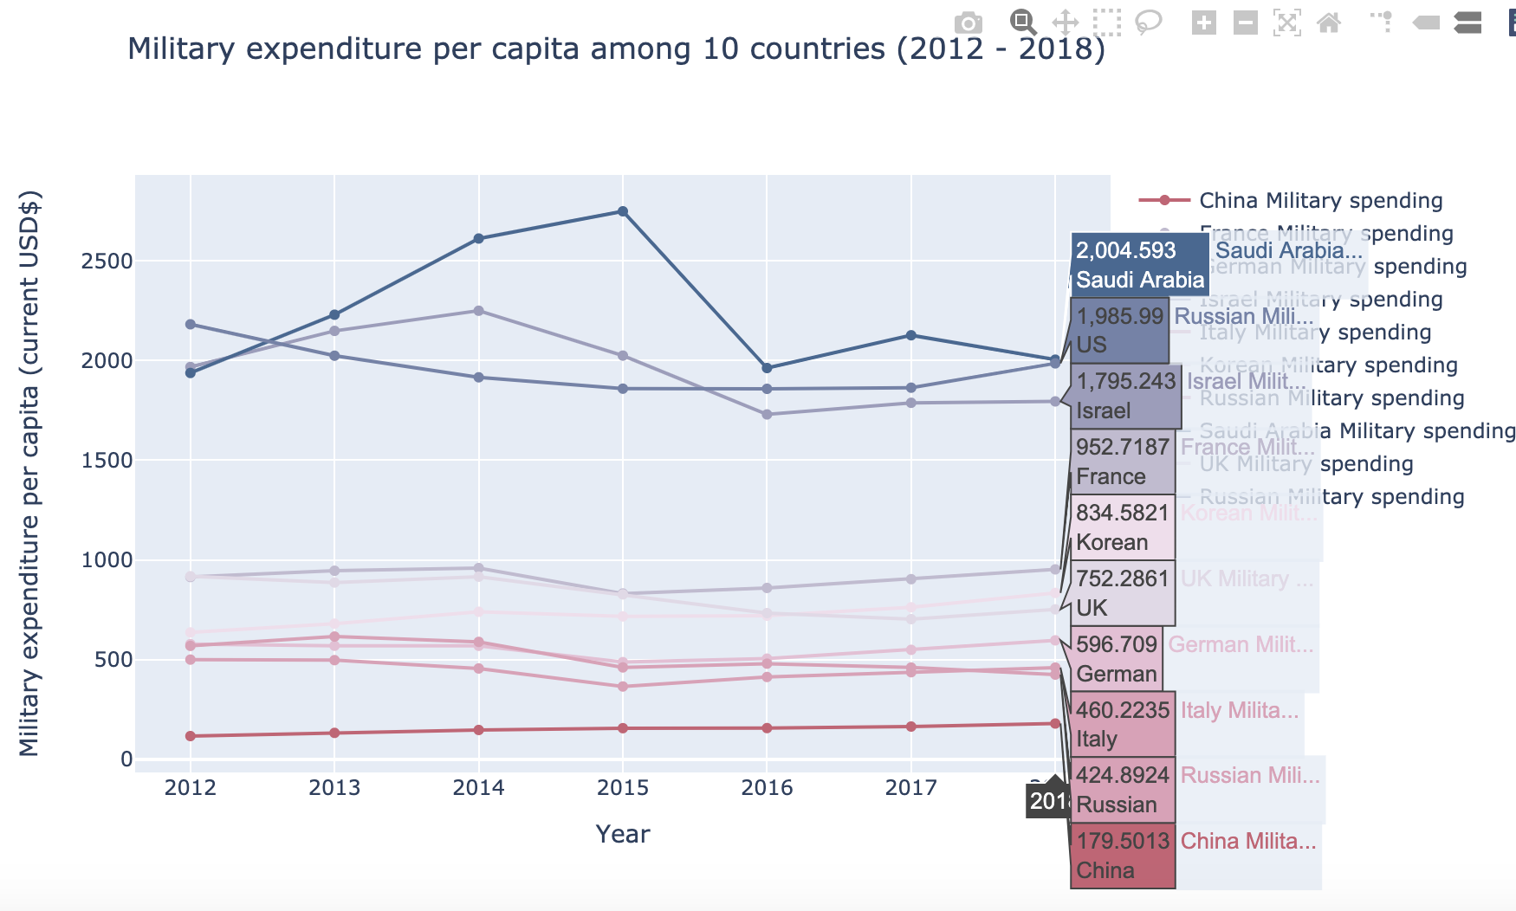
Military per capita
Saudi Arabia has the highest military expenditure per capita among ten countries.
From 2014 to 2015, Saudi Arabia's military expenditure per capita increased rapidly and dropped sharply from 2015 to 2016.
There is a large gap between the top three military expenditures per capita and the rest of the countries.

Slide 13
GDP per capita
The United States has the highest GDP per capita among the ten countries.
By contrast，China has the lowest GDP per capita among the ten countries.
From 2014 to 2015, the GDP per capita of all countries except China and the United States showed a downward trend. After 2016, the GDP per capita began to rise.

Slide 14
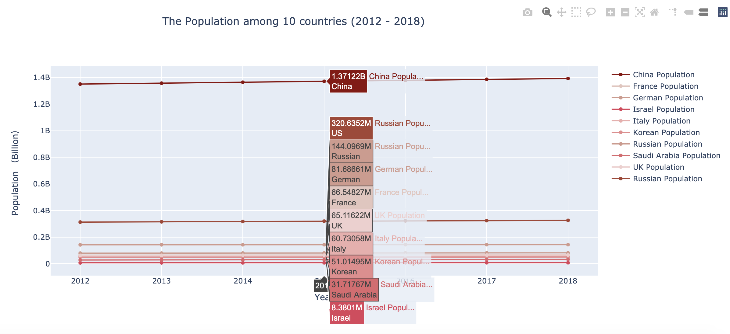
Population
China has the largest population among the ten countries.
There is a big gap between the population of China and that of the U.S.
The remaining countries have relatively small populations.

Slide 15
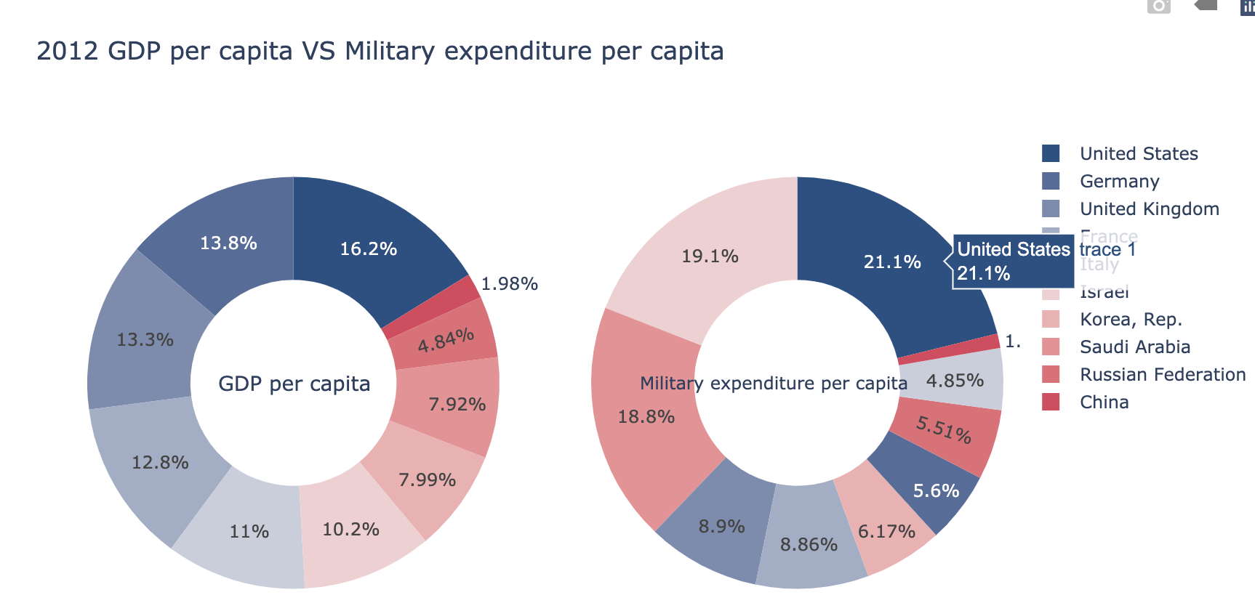
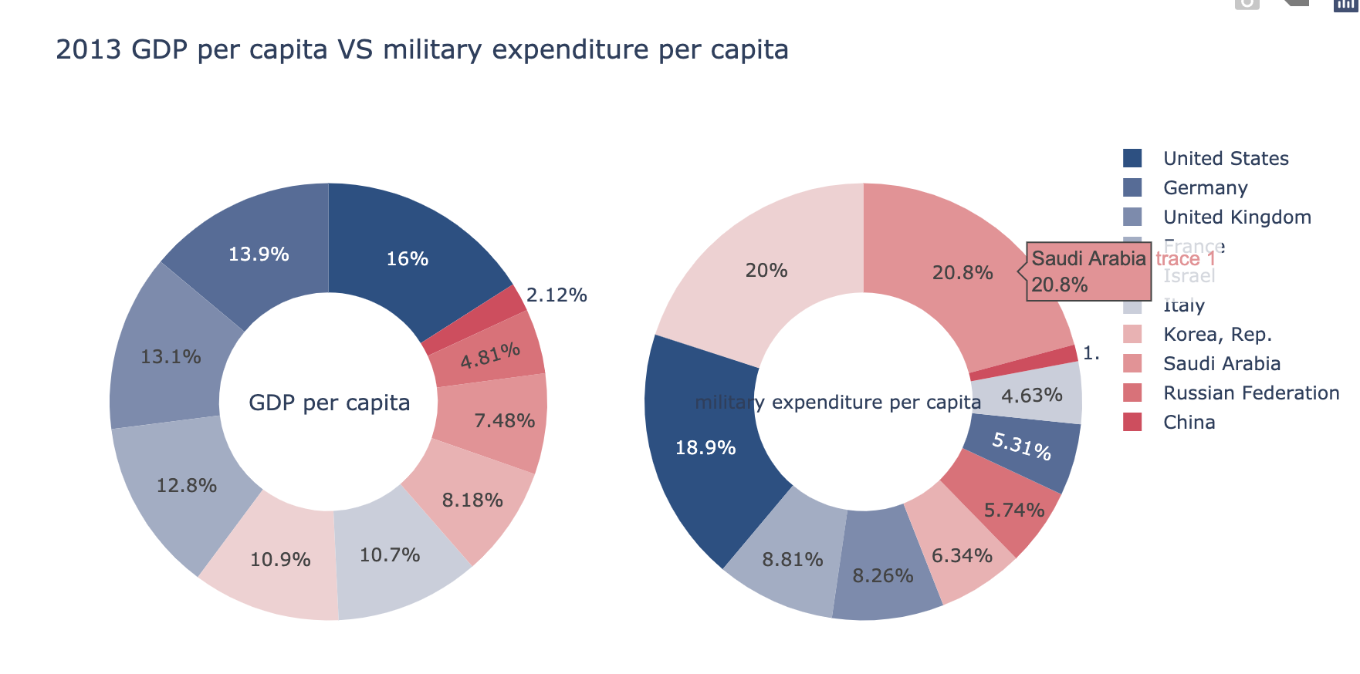
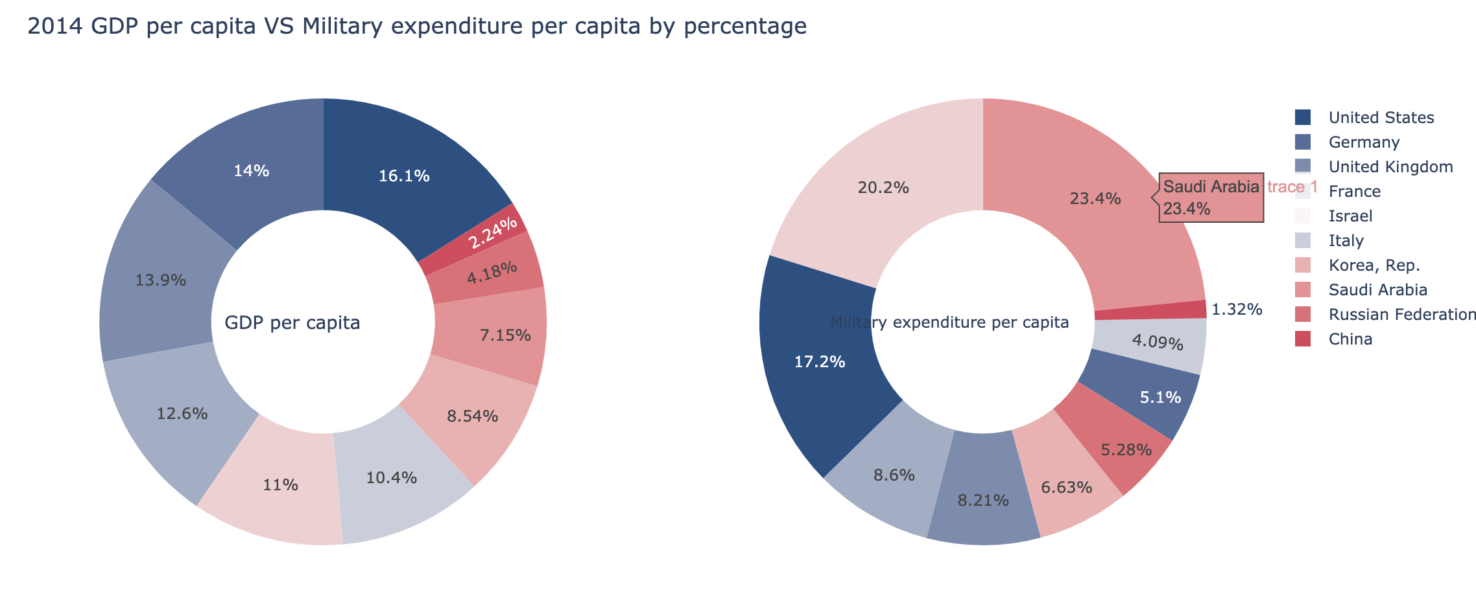
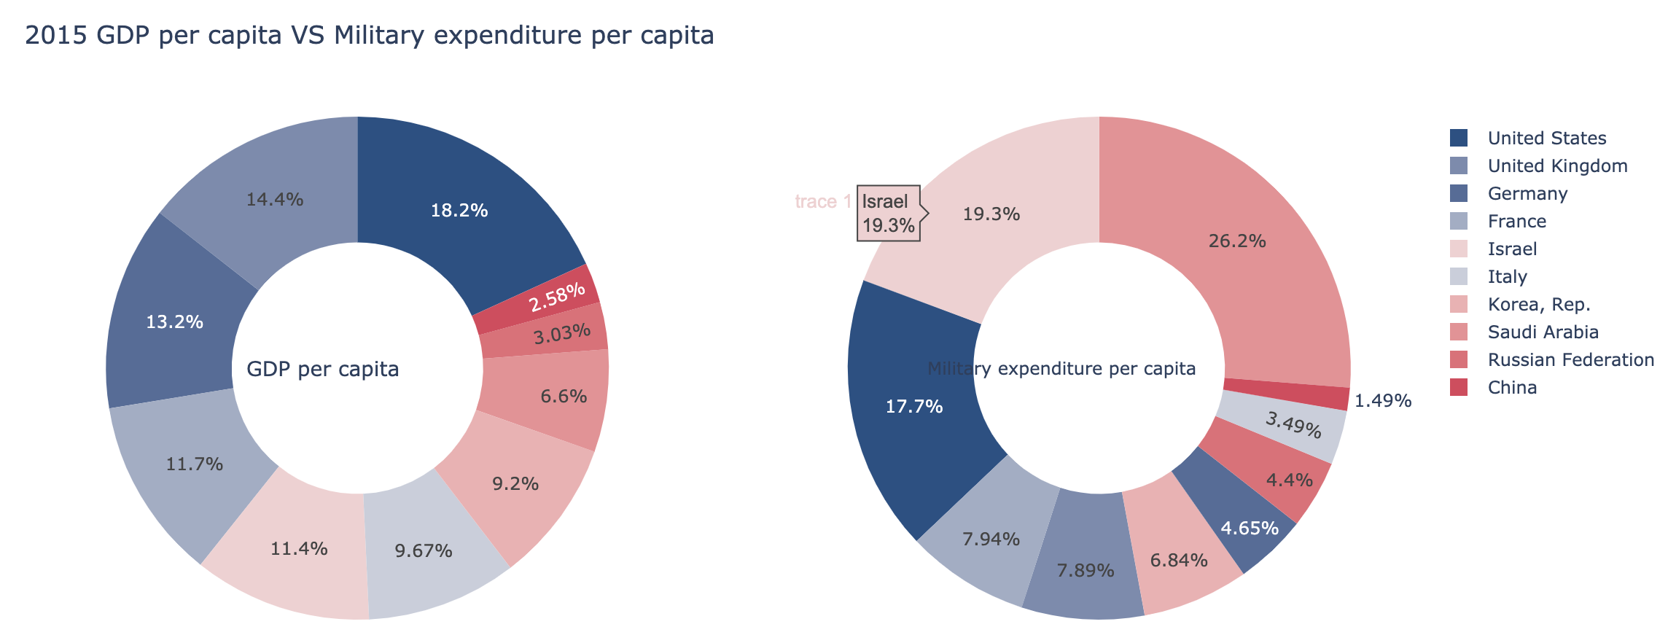
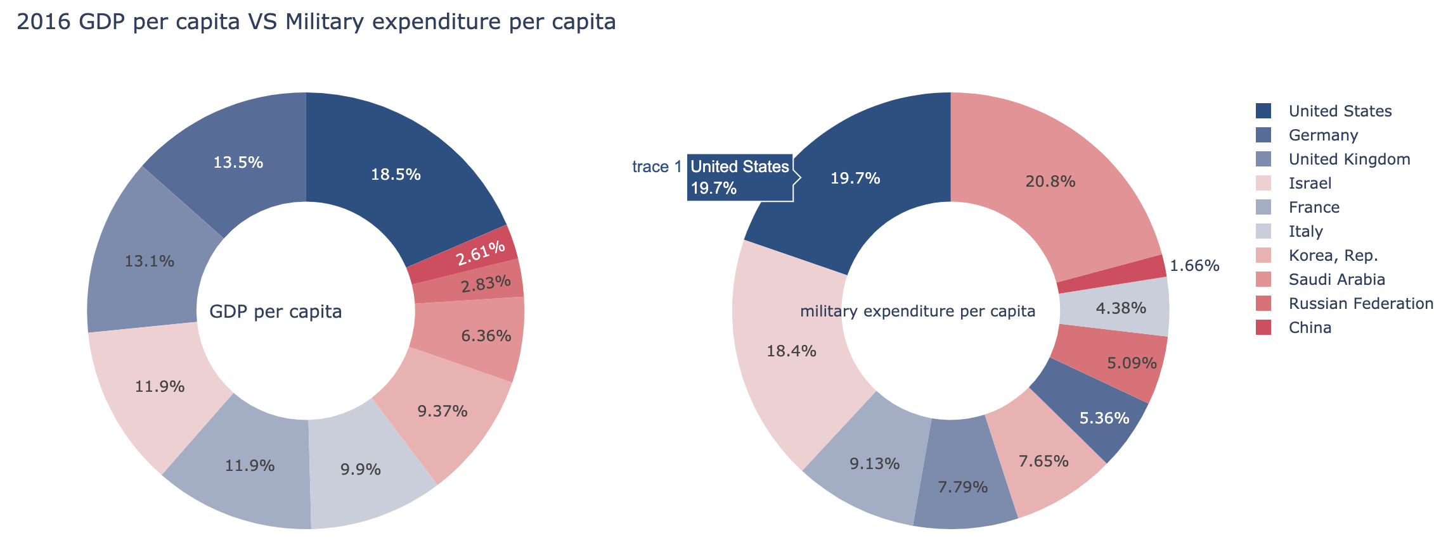
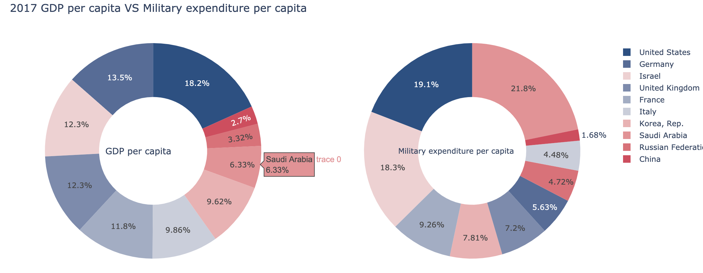
Part III:
2012
2013
2014
2015
Military per capita VS GDP per capita.:
2. By percentage
2016
2017

Slide 16
By percentage
Observed by horizontal:
2012: United States is the highest country in gdp per capita, as well as in military expenditure per capita.
2013: Saudi Arabia replace the United States becomes the highest country in military expenditure per capita.
Observed by vertical:
The United Stated stable at the top country in gdp per capita.
The military expenditure per capital of Saudi Arabia increase faster.

Slide 17
By percentage
Observe horizontally:
Although the gdp per capita of Saudi Arabia is not the top, the military expenditure per capita is the top among ten countries.
Saudi Arabia spend most of money on military.
Observed vertially:
Military spending per capita of Saudi Arabia continue growing.
Both gdp per capita and military per capita of China is the lowest among ten countries.

Slide 18
By percentage
Observe horizontally:
The military expenditure of the United States increased.
Top three countries of military spending per capita is Saudi Arabia, the United States, and Israel.
Observe vertically:
The gdp per capital of Israel is continue growing.

Slide 19
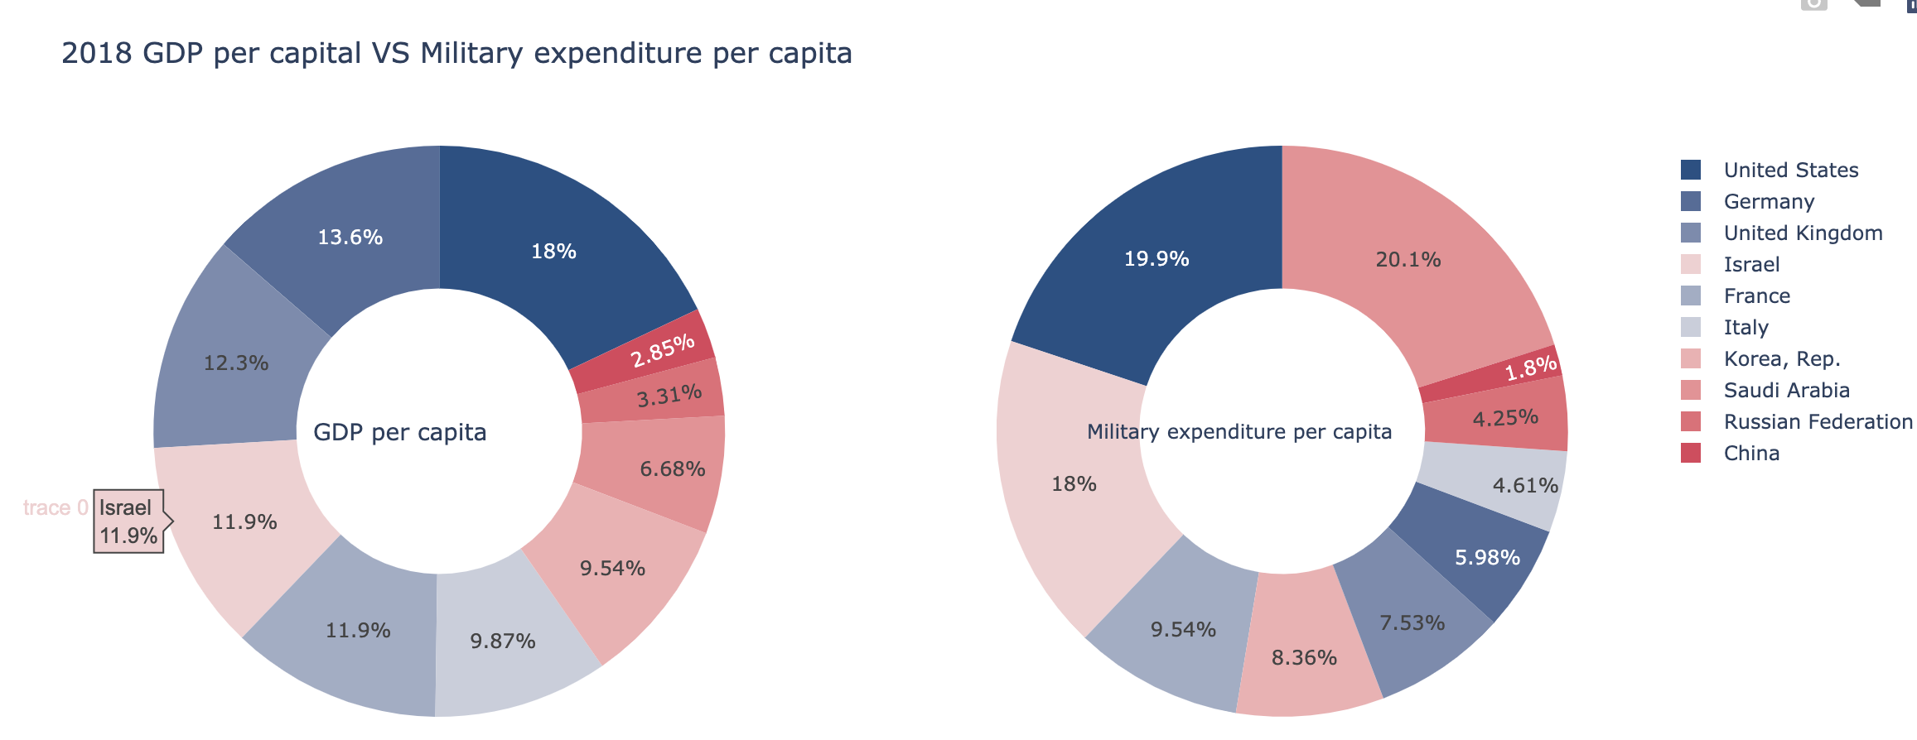
By percentage
Up to 2018:
Saudi Arabia is still the top country of military expenditure per capita.
For both gdp per capita and military spending per capita, China is still the lowest country among ten countries.

Slide 20
Conclusion:
Military expenditure per capita
GDP per capita
Compare the Military per capita and GDP per capita: Saudi Arabia is the highest country in military expenditure per capita, and the United States is the highest country in GDP per capita.
By contrast, China has low military per capita as well as GDP per capita.
One of the reason is that:
China has large population, even the overall GDP and military spending is higher. By contrast, Saudi Arabia has small population.
Although the United States also has a large population, the population is not as many as China.
Population
percentage

Slide 21
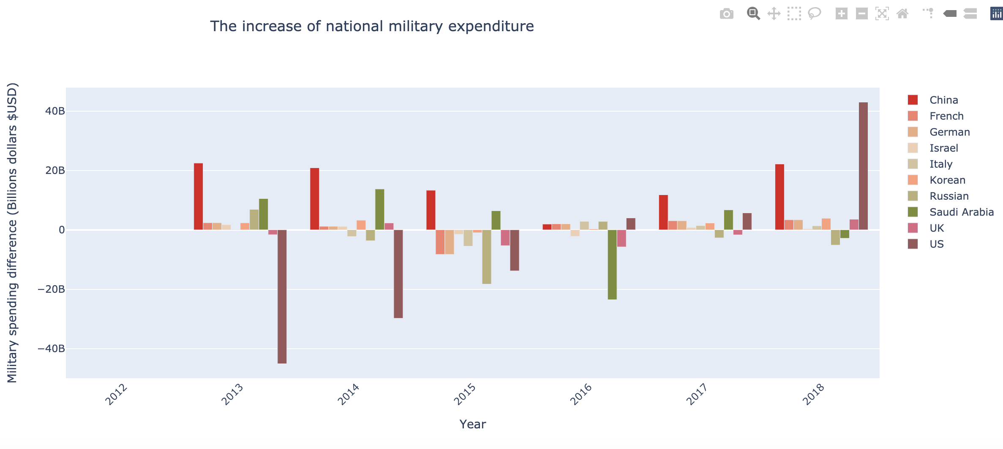
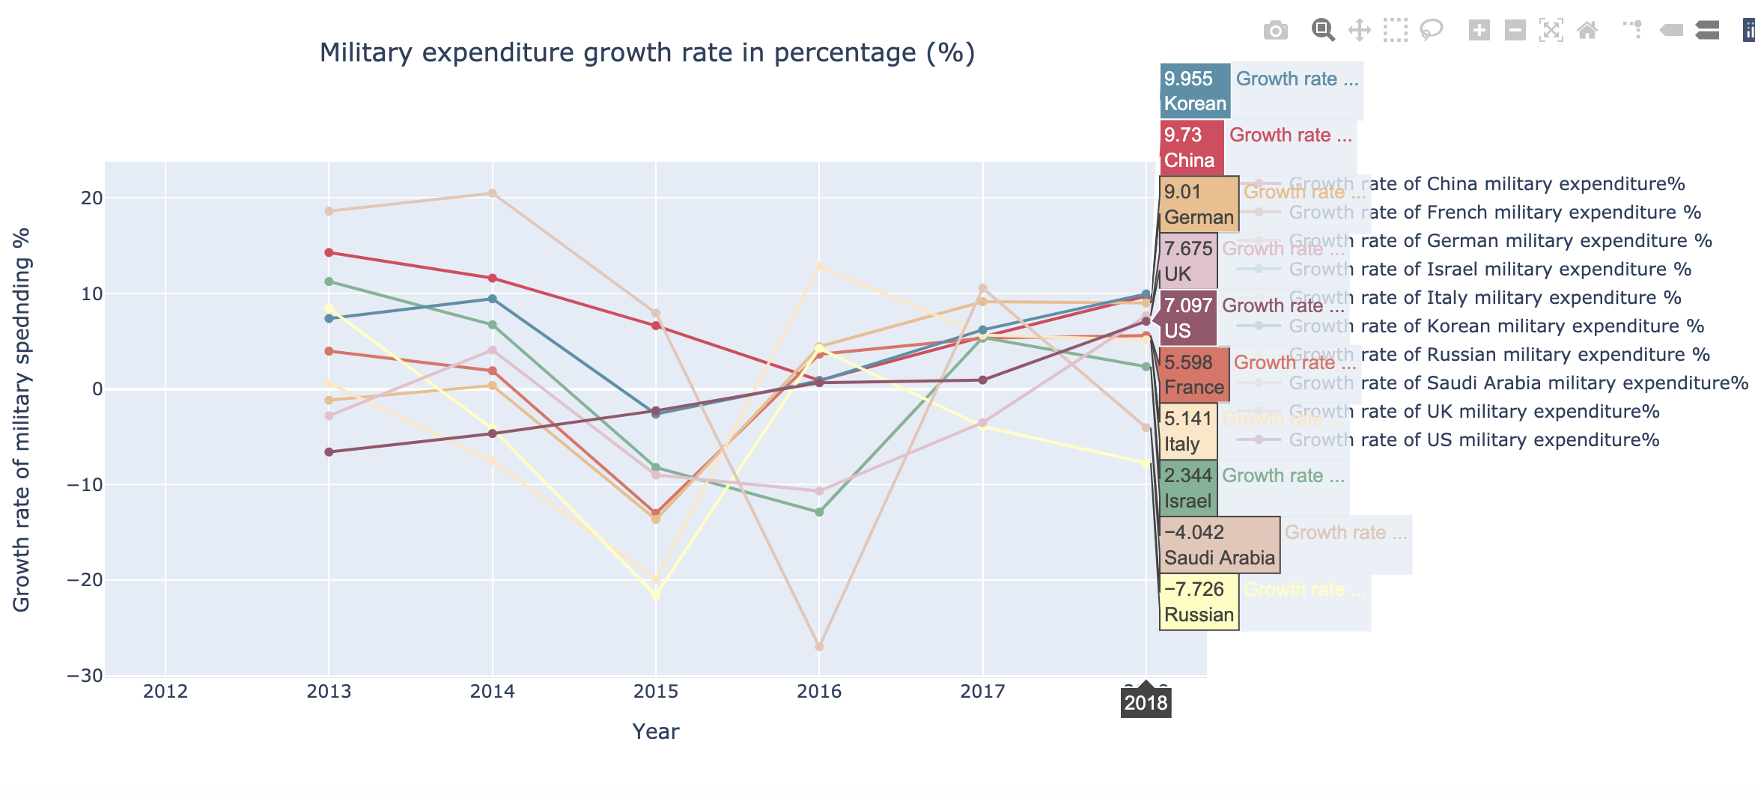
Part IV
Absolute value
The fastest growing countries in military spending
absolute value
percentage
Percentage

Slide 22
The military spending of United States increase a lot among ten countries.

Slide 23
Korean is the fast grow country in military expenditure

Slide 24
Conclution
Absolute value
Based on the graph, South Korean is the fast grow country in military spend among those ten countries as the growth rate is the highest.
The gap between South Korean and China is small, so China is likely surpass the South Korean
Percentage

Slide 25
Data source:
The datasource in this project comes from THE WORLD BANK: https://data.worldbank.org/?name_desc=false.
Graph tool: Plotly

